Slide 1



Cover Page
Thursday, 23 Oct 2025
PROJ703/ PROJ903 International Challenge Project “Eurobot”
By
ROBO-UN
Page-01

Slide 2
Table of Content
Progress Report -03
Simulation -04
Research -05
Electronics-06
Project Management –07+08
Page - 02

Slide 3
PROGRESS REPORT
What we have done:
  Simulation: Fixed earlier issues with imports
  Research: General OpenCV line/object detection
  Strategies: Committed to more basic routing and strategy
  Selection of Electronic Components
What we have to do for next session:
  Simulation: Get a route simulated on a 2D plane
  Design: Adapt design to new route
  Strategies: Optimize the pathing for the simplest route
  Research: Refine the OpenCV templates
  Refining of Electronic Components
Page - 03

Slide 4
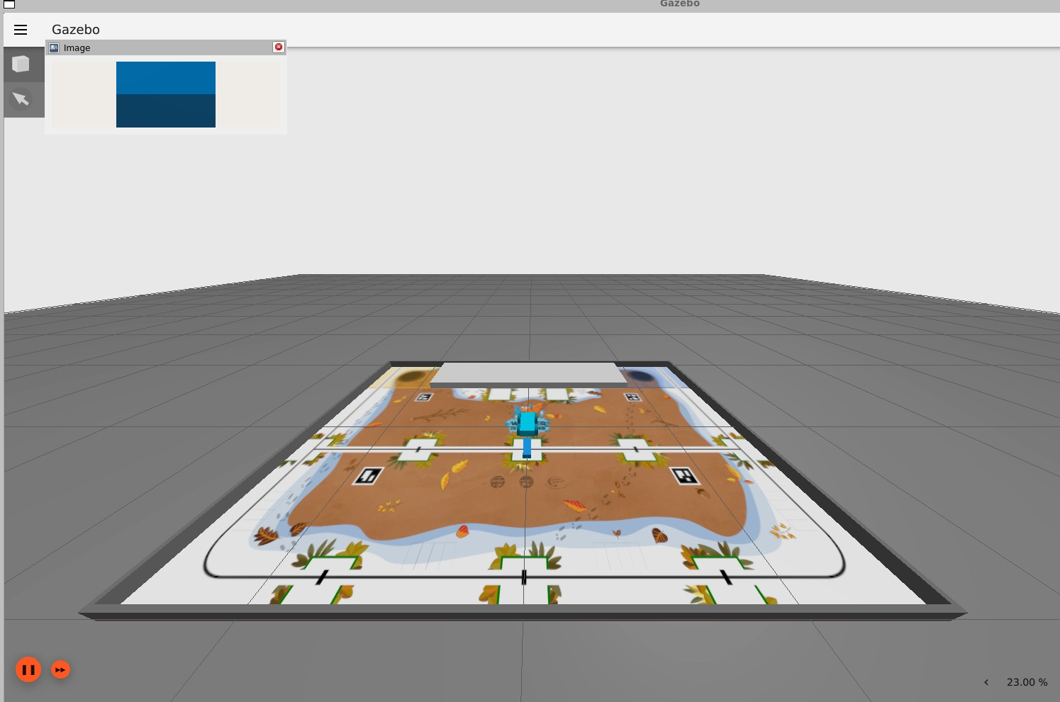
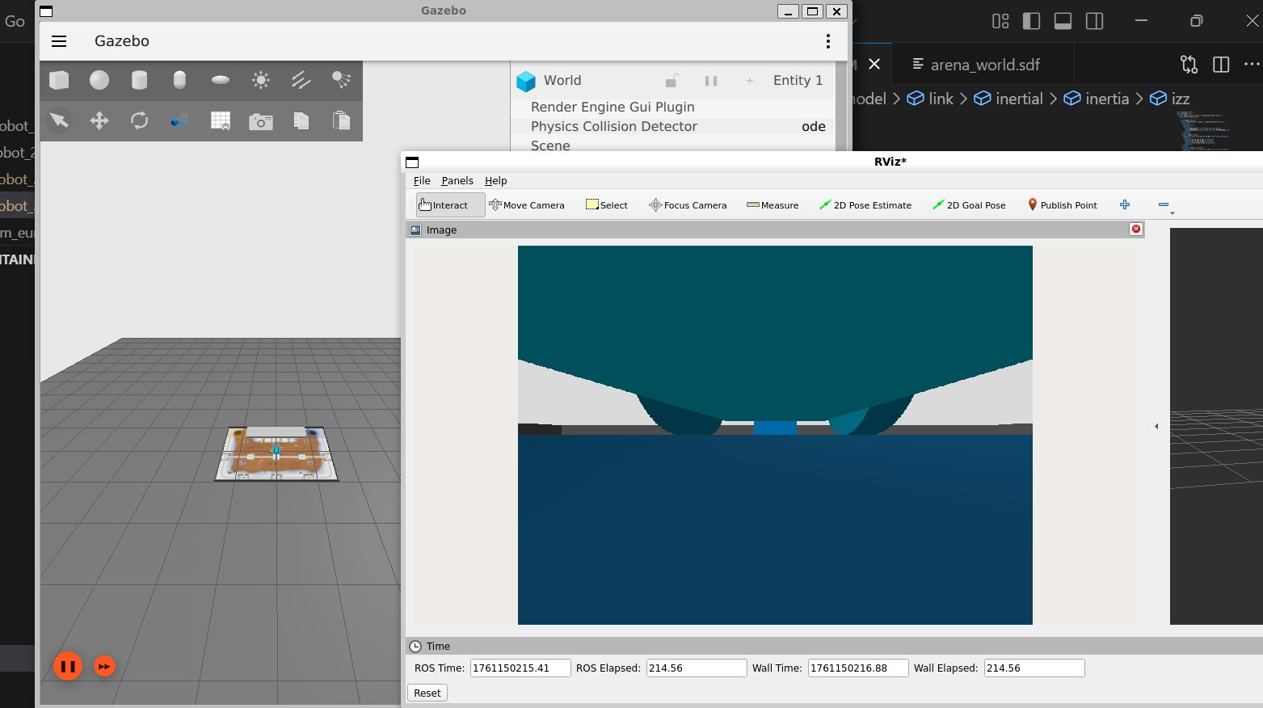
SIMULATION
Added walls to the playmat
Updated the playmat skin
Added camera on the robot
Page - 04

Slide 5
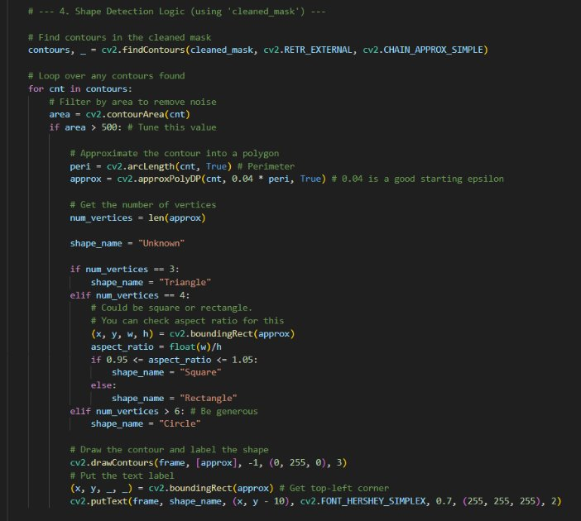
RESEARCH
Designed basic templates for the basic OpenCV functions we need (line following, object/shape detection)
Page - 05

Slide 6
ELECTRONICS
Components | Type
Wheels | Mecanum wheels
Battery | Battery LiPo
Servomotors | MG90 and SG90
Motor drivers | Double BTS7960
Microcontroller 1 | Raspberry PI 4
Microcontroller 2 | ESP32
Camera | IMX219PQ
Ultrasonic sensor | Adafruit 3942
Page - 06

Slide 7
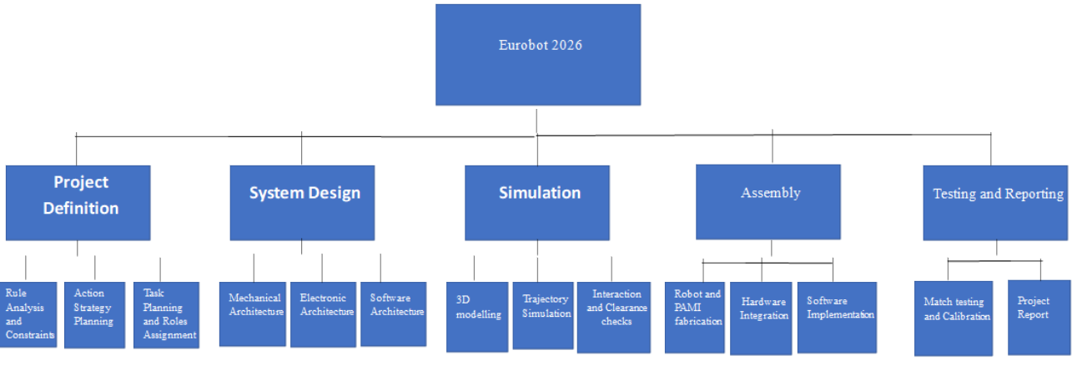
PROJECT MANAGEMENT
WBS
Page - 08

Slide 8
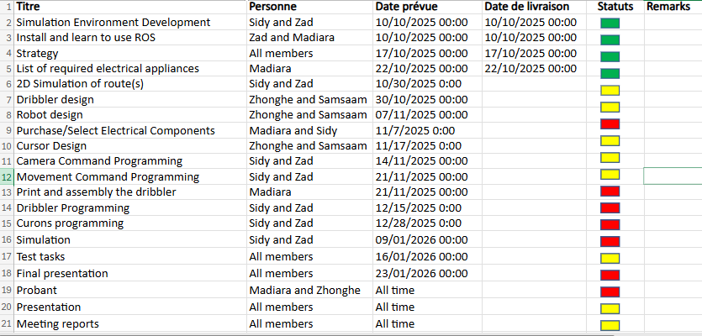
PROJECT MANAGEMENT
Page - 07

